Slide 1
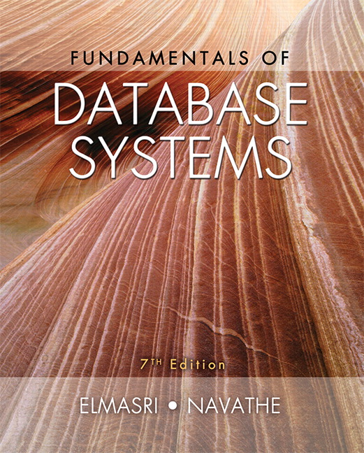

Slide 2
CHAPTER 13
XML: Extensible Markup Language

Slide 3
Introduction
Databases function as data sources for Web applications
HTML
Used in static Web pages
XML, JSON
Self-describing documents
Dynamic Web pages
Chapter focus: XML data model and languages

Slide 4
13.1 Structured, Semistructured, and Unstructured Data
Structured data
Stored in relational database
Semistructured data
Not all data has identical structure
Schema information mixed in
Self-describing
Directed graph model
Unstructured data
Limited data type indication
Example: Web pages in HTML

Slide 5
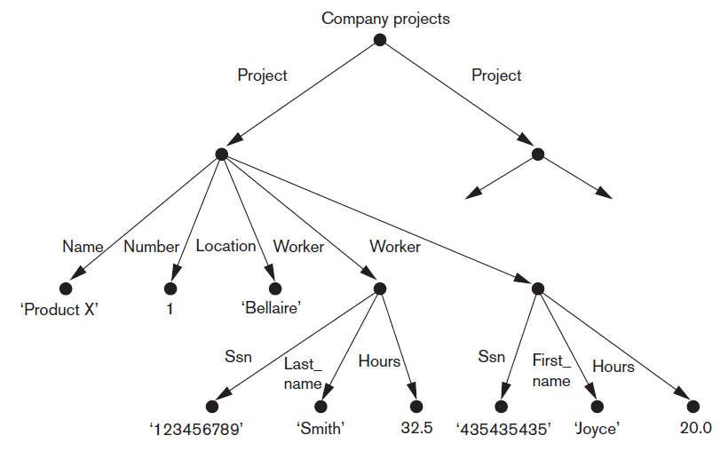
Directed Graph Model for Semistructured Data
Figure 13.1 Representing semistructured data as a graph

Slide 6
Structured, Semistructured, and Unstructured Data (cont’d.)
HTML uses predefined tags
Document header
Script functions, formatting styles
Body
Table tags
Attributes
Large number of predefined tags
XHTML
Extends tags for different applications

Slide 7
13.2 XML Hierarchical (Tree) Data Model
Basic object: XML document
Element
Simple
Complex
Schema document defines element names
Attribute
Document types
Data-centric
Document-centric
Hybrid

Slide 8
13.3 XML Documents, DTD, and XML Schema
Conditions for well-formed XML documents
Begins with XML declaration
Syntactically correct
Valid
Must follow a particular schema

Slide 9
XML Documents, DTD, and XML Schema (cont’d.)
Notation for specifying elements
elementname* indicates optional multivalued (repeating) element
elementname+ indicates required multivalued (repeating) element
elementname? indicates optional single-valued (non-repeating) element
elementname indicates required single-valued (non-repeating) element

Slide 10
XML Documents, DTD, and XML Schema (cont’d.)
Notation for specifying elements (cont’d.)
Type specified by parentheses following the element name
!ATTLIST used to specify attributes within the element
Parentheses can be nested when specifying elements
Bar symbol (e₁|e₂) indicates either e₁ or e₂ can appear in the document

Slide 11
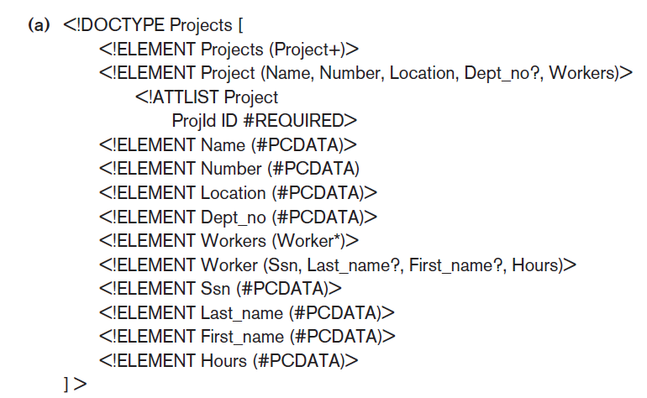
XML Documents, DTD, and XML Schema (cont’d.)
Figure 13.4(a) An XML DTD file called ‘Projects’

Slide 12
XML Schema
XML schema language
Specifies document structure
Same syntax rules as XML documents
Elements, attributes, keys, references, and identifiers
Example: Figure 13.5 in the text

Slide 13
XML Schema (cont’d.)
XML namespace
Defines set of commands that can be used
Annotations, documentation, and language used
Elements and types
Root element
First-level elements
Specifying element type and min and max occurrences

Slide 14
XML Schema (cont’d.)
Keys
Constraints that correspond to relational database
Primary key
Foreign key
Complex elements
xsd:complexType
Composite (compound) attributes

Slide 15
13.4 Storing and Extracting XML Documents from Databases
Use file system or DBMS to store documents as text
Use DBMS to store document contents as data elements
Design specialized system to store XML data
Create or publish custom XML documents from preexisting relational databases
This approach explored further in 13.6

Slide 16
13.5 XML Languages
Query language standards
XPath
XQuery
Specifying XPath expressions in XML
Returns sequence of items satisfying certain pattern
Values, elements, or attributes
Qualifier conditions
Separators
Single slash / or double slash //

Slide 17
XPath (cont’d.)
Example
For COMPANY.XML document stored at location www.company.com/info.XML
doc(www.company.com/infor.XML)/company returns company root node and all descendant nodes

Slide 18
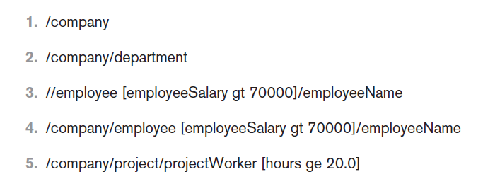
XPath (cont’d.)
Figure 13.6 Some examples of XPath expressions on XML documents that follow the XML schema file company in Figure13.5.

Slide 19
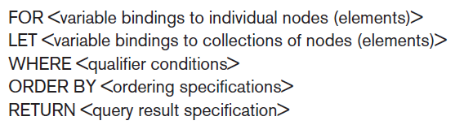
XQuery: Specifying Queries in XML
FLWOR expression
Variables preceded with $
For assigns variable to a range
Where specifies additional conditions
Order by specifies order of result elements
Return specifies elements for retrieval

Slide 20
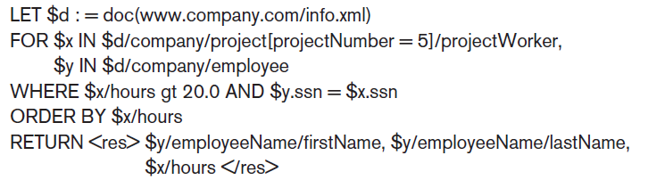
XQuery: Specifying Queries in XML
Example

Slide 21
Other Languages and Protocols Related to XML
Extensible Stylesheet Language (XSL)
Extensible Stylesheet Language for Transformations (XSLT)
Web Services Description Language (WSDL)
Simple Object Access Protocol (SOAP)
Resource Description Framework (RDF)

Slide 22
13.6 Extracting XML Documents from Relational Databases
XML uses hierarchical (tree) model
Common database model is flat relational database
Conceptually represent using ER schema
University example (follows)
Choices for root: course, student, section

Slide 23
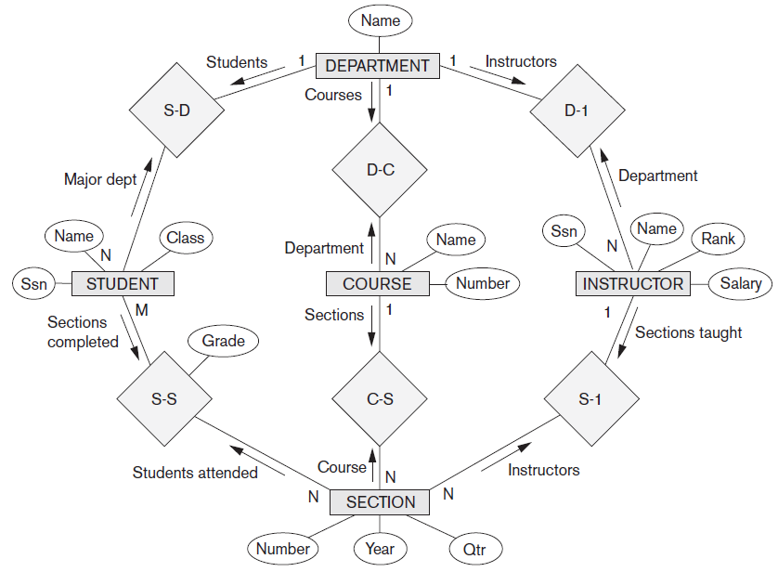
University Example
Figure 13.8 An ER schema diagram for a simplified UNIVERSITY database

Slide 24
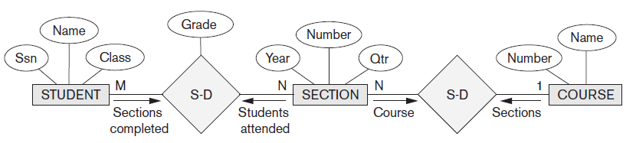
University Example (cont’d.)
Figure 13.9 Subset of the UNIVERSITY database schema needed for XML document extraction

Slide 25
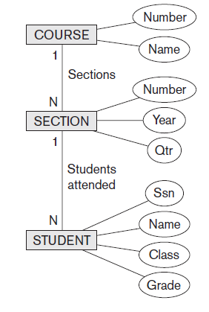
University Example (cont’d.)
Figure 13.10 Hierarchical (tree) view with ‘COURSE’ as the root

Slide 26
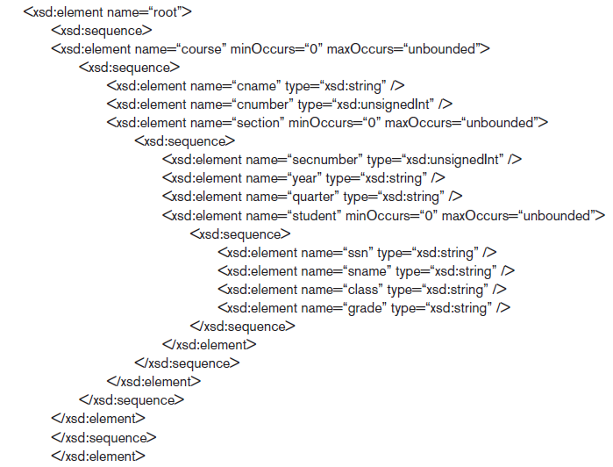
University Example (cont’d.)
Figure 13.11 XML schema with ‘COURSE’ as the root

Slide 27
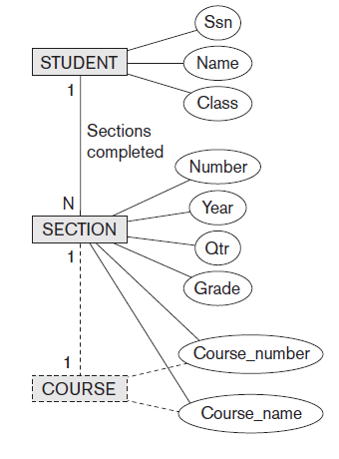
University Example (cont’d.)
Figure 13.12 Hierarchical (tree) view with ‘STUDENT’ as the root

Slide 28
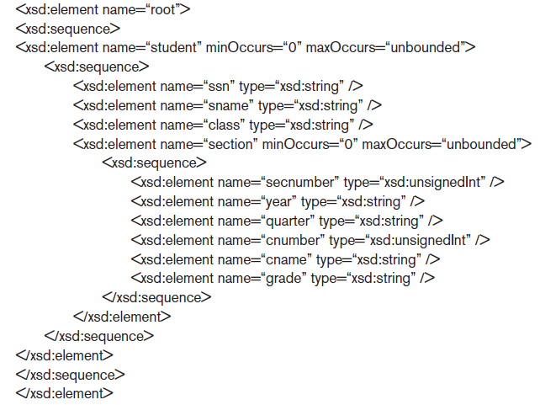
University Example (cont’d.)
Figure 13.13 XML schema document with ‘STUDENT’ as the root

Slide 29
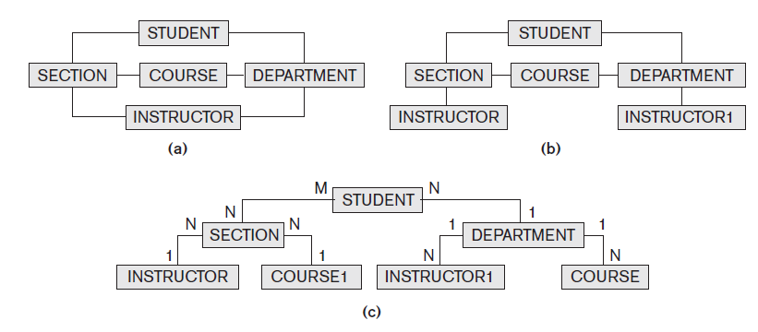
Breaking Cycles to Convert Graphs into Trees

Slide 30
Other Steps for Extracting XML Documents from Databases
Create SQL query to extract desired information
Execute the query
Restructure from flat to tree structure
Customize query to select single or multiple objects into the document

Slide 31
13.7 XML/SQL: SQL Functions for Creating XML Data
XMLELEMENT
Specifies tag (element) name that will appear in XML result
XMLFOREST
Specifies multiple element names
XMLAGG
Aggregate several elements
XMLROOT
Selected elements formatted as XML document with single root element

Slide 32


XML/SQL: SQL Functions for Creating XML Data (cont’d.)
XMLATTRIBUTES
Creates attributes for the elements of the XML result
Example: create XML element containing the EMPLOYEE lastname for the employee with SSN 123456789
Result:

Slide 33
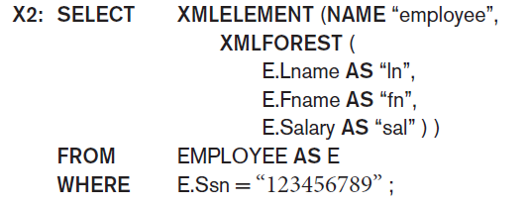
Employee Example (Query 2)
To retrieve multiple columns for a single row:
Result:

Slide 34
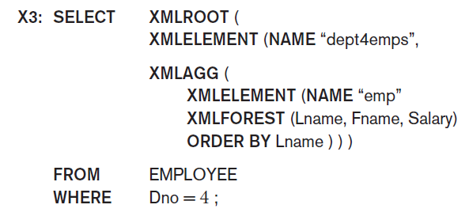
Employee Example (Query 3)
To create XML document with last name, first name, and salary of employees from Dept. 4:

Slide 35
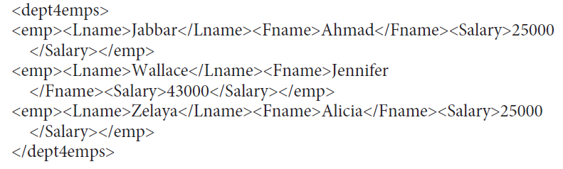
Employee Example (Query 3 cont’d.)
Result:

Slide 36
13.8 Summary
Structured, semistructured, and unstructured data
Hierarchical data model of XML standard
Languages for specifying structure
XML DTD and XML schema
Approaches for storing XML documents
XPath and XQuery languages
Mapping issues
SQL/XML allows formatting query results as XML data

